Slide 1
Mining Evolution and Dynamics of InfoNet
Many networks are with time information
E.g., according to paper publication year, DBLP networks can form network sequences
Motivation: Model evolution of communities in heterogeneous network
Automatically detect the best number of communities in each timestamp
Model the smoothness between communities of adjacent timestamps
Model the evolution structure explicitly
Birth, death, split
EvoNetClus: Modeling evolution of dynamic heterogeneous networks
Co-evolution within a community
heterogeneous multi-typed object/links
Discovery of evolution structures among different communities
Idea: From network sequences to evolutionary communities
Notes:
1

Slide 2
Generative Model & Model Inference
Dirichlet Process Mixture Model-based generative model
At each timestamp, a community is dependent on historical communities and background community distribution
To generate a new paper o_{i}
Decide whether to join an existing community or a new one
Join an existing community k with prob. n_{k}/(i-1+α)
Join a new community k with prob. α/(i- 1 +α): Decide its prior, either from a background distribution (λ) or historical communities ((1- λ)π_{k}), with different probabilities, draw the attribute distribution from the prior
Generate o_{i} according to the attribute distribution
Greedy inference for each timestamp: Collapse Gibbs sampling, which is trying to sample cluster label for each target object (e.g., paper)
Accuracy: The more types of objects used, the better accuracy; Historical prior results in better accuracy

Slide 3
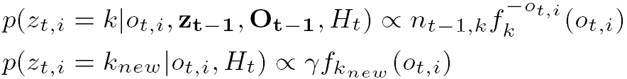
Community Evolution Discovery: Algorithm
Step 1: Generating Prior Groups
Calculation of the posterior probabilities of hidden labels
Step 2: Iterative Hidden Community Label Assignment
Using an EM Algorithm
Step 3: Community Distribution Estimation:

Slide 4
Outline
Motivation: Why Mining Information Networks?
Part I: Clustering and Ranking in Heterogeneous Information Networks
Part II: Classification and Prediction in Heterogeneous Information Networks
Part III: Other Data Mining Functions for Heterogeneous Information Networks
Mining Evolution and Dynamics of Information Networks
Role Discovery
OLAP in Information Networks
Data Cleaning: Distinct
CrossMine: Classification Across Multi-Relational Databases
EgoSet: Exploiting Word Ego-Networks for Multifaceted Set Expansion
Summary

Slide 5
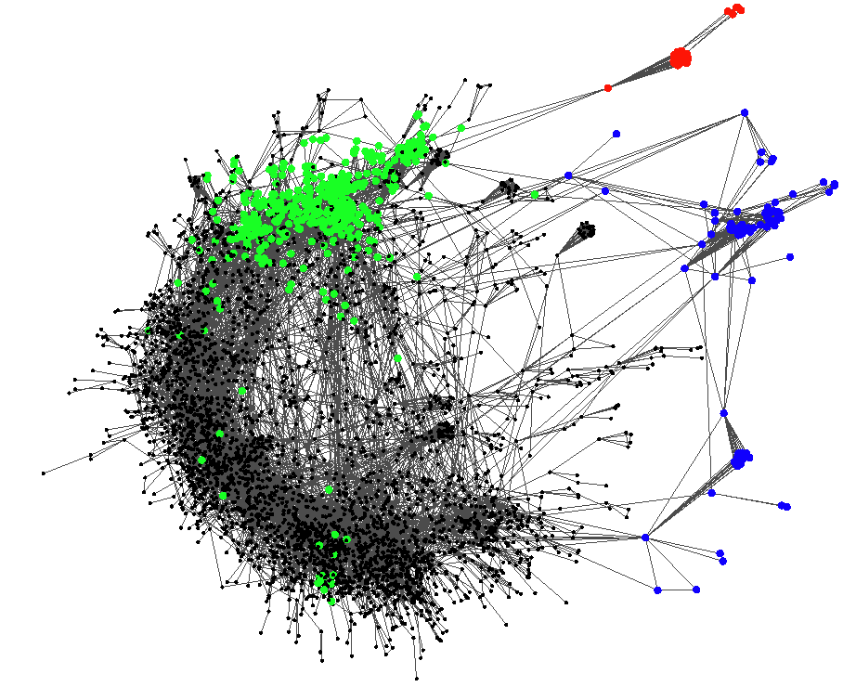
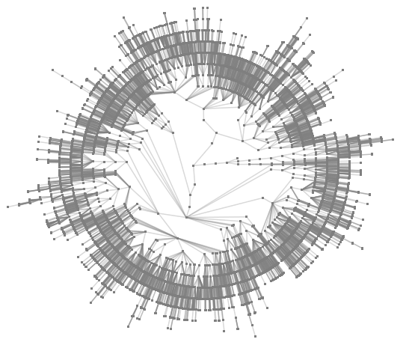
Role Discovery in Networks: Why Does It Matter?
Army communication network (imaginary)
Automatically infer
Commander
Captain
Solider
Notes:
5

Slide 6
Mining Hierarchical Relationships
Objective: Extract semantic meaning from plain links to finely model and better organize information networks
Challenges: Latent semantic knowledge, interdependency, scalability
Mining hierarchical relationships:
Output a tree (forest) for a given set of objects
Examples
Academic family tree
Company organization tree
Online forum discussion tree
Opportunity + heuristics: (i) Human intuition, (ii) Realistic constraint, (iii) Crosscheck with collective intelligence
Methodology: propagate simple intuitive rules and constraints over the whole network
Measures for Finding Advisor and Advisees
Right heuristics: Advisee (B) tends to coauthor with advisor (A) during the advising period
Kulczinski measure :
high overlap between their publications – Kulczinski measure
It is more often to see advisor in a publication but not advisee: Imbalance Ratio measure:
Notes:
6

Slide 7
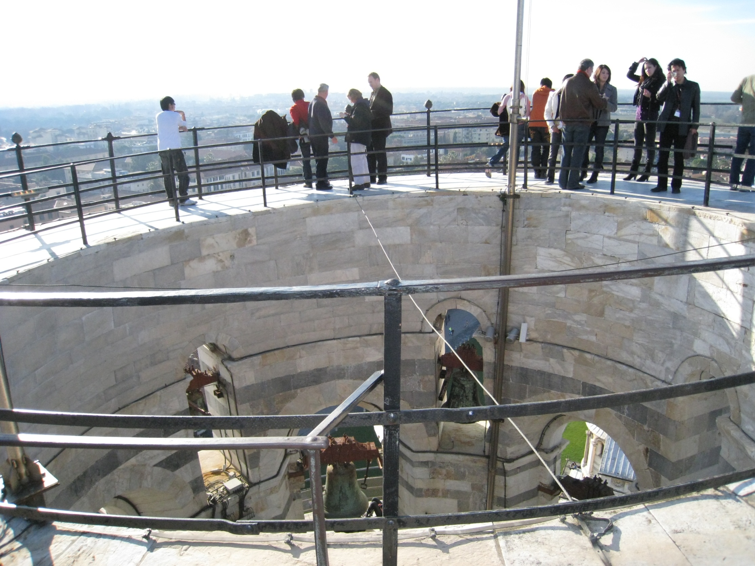

Slide 8
Outline
Motivation: Why Mining Information Networks?
Part I: Clustering and Ranking in Heterogeneous Information Networks
Part II: Classification and Prediction in Heterogeneous Information Networks
Part III: Other Data Mining Functions for Heterogeneous Information Networks
Mining Evolution and Dynamics of Information Networks
Role Discovery
OLAP in Information Networks
Data Cleaning: Distinct
CrossMine: Classification Across Multi-Relational Databases
EgoSet: Exploiting Word Ego-Networks for Multifaceted Set Expansion
Summary

Slide 9
Graph/Network Summarization: Graph Compression
Extract common subgraphs and simplify graphs by condensing these subgraphs into nodes
Notes:
9

Slide 10
OLAP on Information Networks
Why OLAP information networks?
Advantages of OLAP: Interactive exploration of multi-dimensional and multi-level space in a data cube Infonet
Multi-dimensional: Different perspectives
Multi-level: Different granularities
InfoNet OLAP: Roll-up/drill-down and slice/dice on information network data
Traditional OLAP cannot handle this, because they ignore links among data objects
Handling two kinds of InfoNet OLAP
Informational OLAP
Topological OLAP
Notes:
10

Slide 11
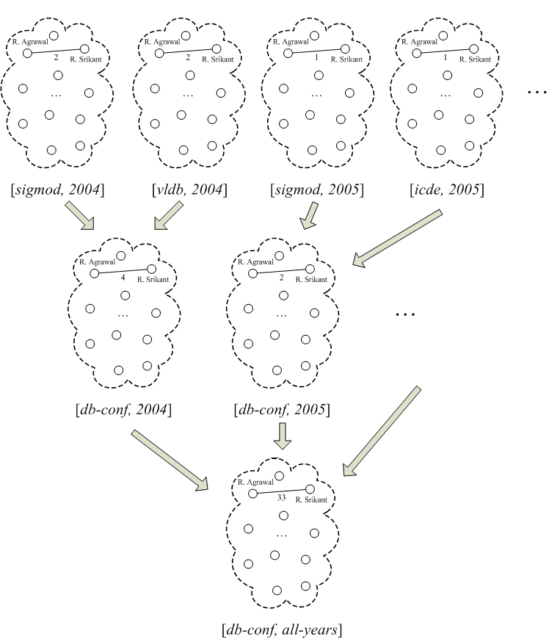
Informational OLAP
In the DBLP network, study the collaboration patterns among researchers
Dimensions come from informational attributes attached at the whole snapshot level, so-called Info-Dims
I-OLAP Characteristics:
Overlay multiple pieces of information
No change on the objects whose interactions are being examined
In the underlying snapshots, each node is a researcher
In the summarized view, each node is still a researcher
Notes:
11

Slide 12
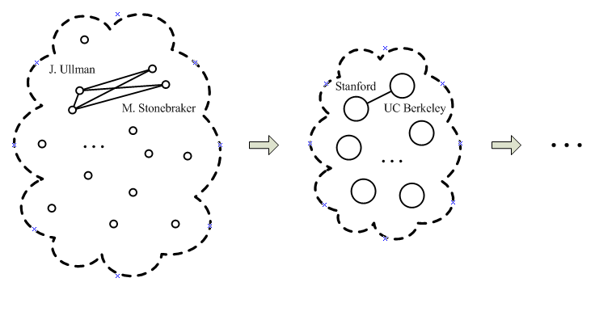
Topological OLAP
Dimensions come from the node/edge attributes inside individual networks, so-called Topo-Dims
T-OLAP Characteristics
Zoom in/Zoom out
Network topology changed: “generalized” nodes and “generalized” edges
In the underlying network, each node is a researcher
In the summarized view, each node becomes an institute that comprises multiple researchers
Notes:
12

Slide 13
InfoNet OLAP: Operations & Framework
 | InfoNet I-OLAP | InfoNet T-OLAP
Roll-up | Overlay multiple snapshots to form a higher-level summary via I-aggregated network | Shrink the topology & obtain a T-aggregated network that represents a compressed view, with topological elements (i.e., nodes and/or edges) merged and replaced by corresp. higher-level ones
Drill-down | Return to the set of lower-level snapshots from the higher-level overlaid (aggregated) network | A reverse operation of roll-up
Slice/dice | Select a subset of qualifying snapshots based on Info-Dims | Select a subnetwork based on Topo-Dims
Measure is an aggregated graph & other measures like node count, average and degree can be treated as derived
Graph plays a dual role: (1) data source, and (2) aggregate measure
Measures could be complex, e.g., maximum flow, shortest path, centrality
It is possible to combine I-OLAP and T-OLAP into a hybrid case
Notes:
13

Slide 14
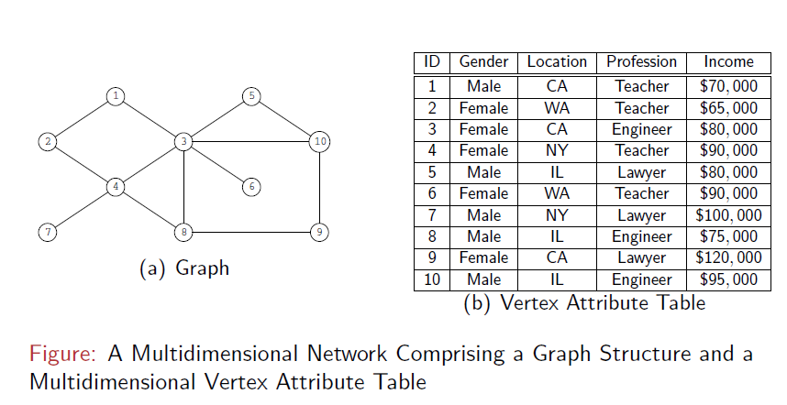
Graph Cube: Online Analytical Processing in Multidimensional Information Networks
A Multidimensional Information Network
Notes:
An underlying graph structure comprising entities and relationships
Multidimensional attributes are specified and associated with entities of the network
There exist considerable technology gaps in managing, querying and summarizing multidimensional networks effectively

Slide 15
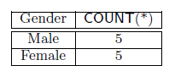
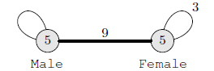
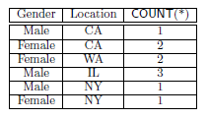
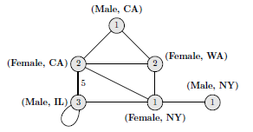
Conventional Group-by vs. Network Summarization
Group by “Gender”
Group by “Gender” and “Location”
Notes:
For edges with no weights, it means the weight is 1 by default!

Slide 16
The Graph Cube Model
Multidimensional network N = (V, E; A)
A = {A₁, A₂, ……, A_{n}}, the dimension of the network N, is a set of n vertex-specific attributes
Some (or all) dimension A_{i} could be *(ALL), representing a super-aggregation along A_{i}
There exist 2^{n} multidimensional spaces (aggregations)
The measure within each possible space is no longer a simple numeric value, but an aggregate network!

Slide 17
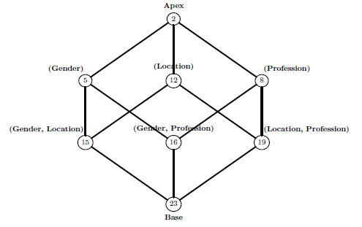
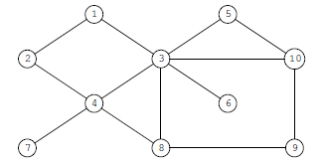
The Graph Cube Model
Graph Cube
Restructure the network in all possible multidimensional spaces (cuboids) defined on A
For each multidimensional space A’, the measure is an aggregate network w.r.t. A’

Slide 18
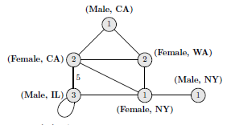
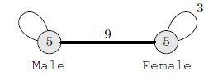
OLAP on Graph Cube
Cuboid query
Return as output the aggregate network corresponding to a specific multidimensional space (cuboid)
What is the aggregate network between various genders?
What is the aggregate network between various gender and location combinations?

Slide 19
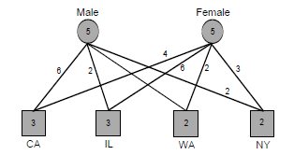
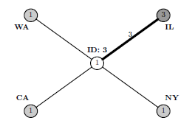
OLAP on Graph Cube
Cuboid query
Within a single multidimensional space
Crossboid query (⋈)
Crosses multiple multidimensional spaces of the network
What is the network structure between user 3 and various locations?
What is the network structure between users grouped by gender vs. users grouped by location?
σ_{ID=3}
⋈
⋈
Gender
Location
Base
Location
Notes:
Cuboid query follows the conventional OLAP model
more than one cuboid is involved in a query

Slide 20


Slide 21
Outline
Motivation: Why Mining Information Networks?
Part I: Clustering and Ranking in Heterogeneous Information Networks
Part II: Classification and Prediction in Heterogeneous Information Networks
Part III: Other Data Mining Functions for Heterogeneous Information Networks
Mining Evolution and Dynamics of Information Networks
Role Discovery
OLAP in Information Networks
Data Cleaning: Distinct
CrossMine: Classification Across Multi-Relational Databases
EgoSet: Exploiting Word Ego-Networks for Multifaceted Set Expansion
Summary

Slide 22
Data Cleaning by Link Analysis
Object reconciliation vs. object distinction as data cleaning tasks
Link analysis may take advantages of redundancy and make facilitate entity cross-checking and validation
Object distinction: Different people/objects do share names
In AllMusic.com, 72 songs and 3 albums named “Forgotten” or “The Forgotten”
In DBLP, 141 papers are written by at least 14 “Wei Wang”
New challenges of object distinction:
Textual similarity cannot be used
Distinct: Object distinction by information network analysis
X. Yin, J. Han, and P. S. Yu, “Object Distinction: Distinguishing Objects with Identical Names by Link Analysis”, ICDE'07
Notes:
22

Slide 23
Entity Distinction: The “Wei Wang” Challenge in DBLP
(1)
(2)
Wei Wang, Jiong Yang, Richard Muntz | VLDB | 1997
Wei Wang, Haifeng Jiang, Hongjun Lu, Jeffrey Yu | VLDB | 2004
Haixun Wang, Wei Wang, Jiong Yang, Philip S. Yu | SIGMOD | 2002
Hongjun Lu, Yidong Yuan, Wei Wang, Xuemin Lin | ICDE | 2005
Jiong Yang, Hwanjo Yu, Wei Wang, Jiawei Han | CSB | 2003
Wei Wang, Xuemin Lin | ADMA | 2005
Jiong Yang, Jinze Liu, Wei Wang | KDD | 2004
Jian Pei, Jiawei Han, Hongjun Lu, et al. | ICDM | 2001
Jinze Liu, Wei Wang | ICDM | 2004
(4)
Jian Pei, Daxin Jiang, Aidong Zhang | ICDE | 2005
Aidong Zhang, Yuqing Song, Wei Wang | WWW | 2003
(3)
Wei Wang, Jian Pei, Jiawei Han | CIKM | 2002
Haixun Wang, Wei Wang, Baile Shi, Peng Wang | ICDM | 2005
Yongtai Zhu, Wei Wang, Jian Pei, Baile Shi, Chen Wang | KDD | 2004
(1) Wei Wang at UNC (2) Wei Wang at UNSW, Australia
(3) Wei Wang at Fudan Univ., China (4) Wei Wang at SUNY Buffalo
Notes:
23

Slide 24
The DISTINCT Methodology
Measure similarity between references
Link-based similarity: Linkages between references
References to the same object are more likely to be connected (Using random walk probability)
Neighborhood similarity
Neighbor tuples of each reference can indicate similarity between their contexts
Self-boosting: Training using the “same” bulky data set
Reference-based clustering
Group references according to their similarities
Notes:
24

Slide 25
Training with the “Same” Data Set
Build a training set automatically
Select distinct names, e.g., Johannes Gehrke
The collaboration behavior within the same community share some similarity
Training parameters using a typical and large set of “unambiguous” examples
Use SVM to learn a model for combining different join paths
Each join path is used as two attributes (with link-based similarity and neighborhood similarity)
The model is a weighted sum of all attributes
Notes:
25

Slide 26
Clustering: Measure Similarity between Clusters
Single-link (highest similarity between points in two clusters) ?
No, because references to different objects can be connected.
Complete-link (minimum similarity between them)?
No, because references to the same object may be weakly connected.
Average-link (average similarity between points in two clusters)?
A better measure
Refinement: Average neighborhood similarity and collective random walk probability
Notes:
26

Slide 27
Real Cases: DBLP Popular Names
Name | #author | #ref | accuracy | precision | recall | f-measure
Hui Fang | 3 | 9 | 1.0 | 1.0 | 1.0 | 1.0
Ajay Gupta | 4 | 16 | 1.0 | 1.0 | 1.0 | 1.0
Joseph Hellerstein | 2 | 151 | 0.81 | 1.0 | 0.81 | 0.895
Rakesh Kumar | 2 | 36 | 1.0 | 1.0 | 1.0 | 1.0
Michael Wagner | 5 | 29 | 0.395 | 1.0 | 0.395 | 0.566
Bing Liu | 6 | 89 | 0.825 | 1.0 | 0.825 | 0.904
Jim Smith | 3 | 19 | 0.829 | 0.888 | 0.926 | 0.906
Lei Wang | 13 | 55 | 0.863 | 0.92 | 0.932 | 0.926
Wei Wang | 14 | 141 | 0.716 | 0.855 | 0.814 | 0.834
Bin Yu | 5 | 44 | 0.658 | 1.0 | 0.658 | 0.794
average |  |  | 0.81 | 0.966 | 0.836 | 0.883
Notes:
27

Slide 28
Distinguishing Different “Wei Wang”s
UNC-CH
(57)
Fudan U, China
(31)
Zhejiang U
China
(3)
Najing Normal
China
(3)
5
SUNY
Binghamton
(2)
Ningbo Tech
China
(2)
2
UNSW, Australia
(19)
Purdue
(2)
Chongqing U
China
(2)
SUNY
Buffalo
(5)
6
Beijing
Polytech
(3)
NU
Singapore
(5)
Harbin U
China
(5)
Beijing U Com
China
(2)
Notes:
28

Slide 29
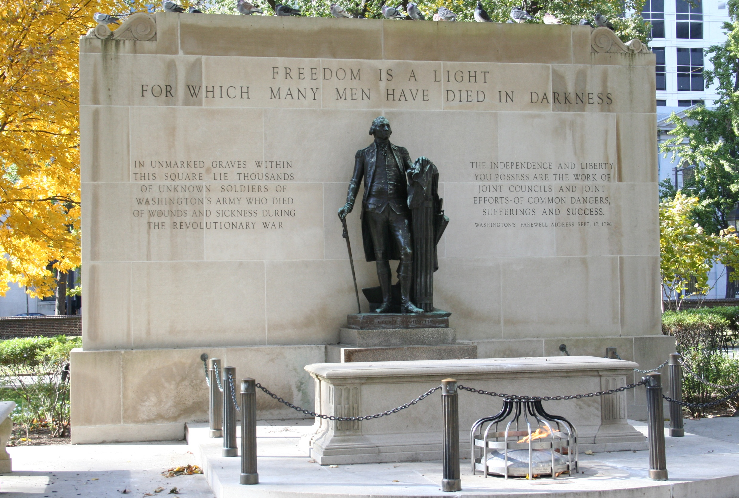

Slide 30
Outline
Motivation: Why Mining Information Networks?
Part I: Clustering and Ranking in Heterogeneous Information Networks
Part II: Classification and Prediction in Heterogeneous Information Networks
Part III: Other Data Mining Functions for Heterogeneous Information Networks
Mining Evolution and Dynamics of Information Networks
Role Discovery
OLAP in Information Networks
Data Cleaning: Distinct
CrossMine: Classification Across Multi-Relational Databases
EgoSet: Exploiting Word Ego-Networks for Multifaceted Set Expansion
Summary

Slide 31

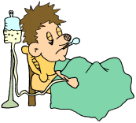
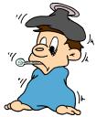

Should We Flatten Relations at Multi-Relational Mining?
Folding multiple relations into a single “flat” one for mining?
Contact
Doctor
Patient
flatten
Joining multiple relations? Cannot be a solution due to problems
Lose information of linkages and relationships, no semantics preservation
Cannot utilize information of database structures or schemas (e.g., E-R modeling)
Joining may distort the real quantitative relationship
Notes:
31

Slide 32
Loan Applications: Backend Database
Account
District
Loan
account-id
district-id
Target relation:
Each tuple has a class label, indicating whether a loan is paid on time.
loan-id
district-id
dist-name
account-id
frequency
Card
region
date
date
card-id
#people
amount
disp-id
#lt-500
duration
Transaction
type
#lt-2000
payment
trans-id
issue-date
#lt-10000
#gt-10000
account-id
#city
date
Disposition
ratio-urban
Order
type
disp-id
order-id
avg-salary
operation
account-id
unemploy95
account-id
amount
client-id
bank-to
unemploy96
balance
den-enter
account-to
symbol
Client
amount
#crime95
client-id
#crime96
type
birth-date
gender
district-id
How to make decisions to loan applications?
Notes:
32

Slide 33
CrossMine: An Effective Multi-relational Classifier
Methodology
Tuple-ID propagation: an efficient and flexible method for virtually joining relations
Confine the rule search process in promising directions
Look-one-ahead: a more powerful search strategy
Negative tuple sampling: improve efficiency while maintaining accuracy
Notes:
33

Slide 34
Tuple ID Propagation
Loan ID | Account ID | Amount | Duration | Decision
1 | 124 | 1000 | 12 | Yes
2 | 124 | 4000 | 12 | Yes
3 | 108 | 10000 | 24 | No
4 | 45 | 12000 | 36 | No
Applicant #1
Applicant #2
Account ID
Frequency
Open date
Propagated ID
Labels
124
monthly
02/27/93
1, 2
2+, 0–
108
weekly
09/23/97
3
0+, 1–
45
monthly
12/09/96
4
0+, 1–
Applicant #3
67
weekly
01/01/97
Null
0+, 0–
Possible predicates:
Frequency=‘monthly’: 2 +, 1 –
Open date < 01/01/95: 2 +, 0 –
Applicant #4
Propagate tuple IDs of target relation to non-target relations
Virtually join relations to avoid the high cost of physical joins
Notes:
34

Slide 35
Tuple ID Propagation (Idea Outlined)
Efficient
Only propagate the tuple IDs
Time and space usage is low
Flexible
Can propagate IDs among non-target relations
Many sets of IDs can be kept on one relation, which are propagated from different join paths
Target Relation
R₁
R₂
R₃
Notes:
35

Slide 36
Rule Generation: Example
Account
District
Target relation
Loan
account-id
district-id
loan-id
district-id
dist-name
account-id
frequency
Card
region
Rule Generation
Start at the target relation
Repeat
Search in all active relations
Search in all relations joinable to active relations
Add the best predicate to the current rule
Set the involved relation to active
Until
The best predicate does not have enough gain
Current rule is too long
date
date
card-id
#people
amount
First predicate
disp-id
#lt-500
duration
Transaction
type
#lt-2000
payment
trans-id
issue-date
#lt-10000
#gt-10000
account-id
#city
date
Disposition
ratio-urban
Order
type
disp-id
order-id
avg-salary
operation
account-id
unemploy95
account-id
amount
client-id
bank-to
unemploy96
balance
den-enter
account-to
symbol
Client
amount
#crime95
client-id
#crime96
type
birth-date
Second predicate
gender
district-id
Notes:
36

Slide 37
Look-One-Ahead in Rule Generation
Two types of relations: Entity and Relationship
Often cannot find useful predicates on relations of relationship
No good predicate
Target
Relation
Solution of CrossMine:
When propagating IDs to a relation of relationship, propagate one more step to next relation of entity
Notes:
37
If a relation has multiple foreign keys but no primary key, it is a relation of relationship.

Slide 38
Rule Induction: An Inductive Logic Programming (ILP) Approach
Find a hypothesis that is consistent with background knowledge (training data)
FOIL, Golem, Progol, TILDE, …
Background knowledge
Relations (predicates), Tuples (ground facts)
Inductive Logic Programming (ILP)
Hypothesis: The hypothesis is usually a set of rules, which can predict certain attributes in certain relations
Daughter(X, Y) ← female(X), parent(Y, X)
Training examples
Background knowledge
Daughter(mary, ann) | +
Daughter(eve, tom) | +
Daughter(tom, ann) | –
Daughter(eve, ann) | –
Female(ann)
Female(mary)
Female(eve)
Parent(ann, mary)
Parent(ann, tom)
Parent(tom, eve)
Parent(tom, ian)
Notes:
38

Slide 39
FOIL: First-Order Inductive Learner (Rule Generation)
Find a set of rules consistent with training data
A top-down, sequential covering learner
Build each rule by heuristics
Foil gain – a special type of information gain
Examples covered
by Rule 2
A3=1
Examples covered
by Rule 1
A3=1&&A1=2
Examples covered
by Rule 3
A3=1&&A1=2
&&A8=5
All examples
To generate a rule
while(true)
find the best predicate p
if foil-gain(p)>threshold then add p to current rule
else break
Negative examples
Positive examples
Notes:
39

Slide 40
Find the Best Predicate: Predicate Evaluation
All predicates in a relation can be evaluated based on propagated IDs
Use foil-gain to evaluate predicates
Suppose current rule is r. For a predicate p,
foil-gain(p) =
Categorical Attributes
Compute foil-gain directly
Numerical Attributes
Discretize with every possible value
Notes:
40
P(r) (or N(r)) is the number of positive (or negative) target tuples satisfying a rule r.

Slide 41
Negative Tuple Sampling
Each time a rule is generated, covered positive examples are removed
After generating many rules, there are much less positive examples than negative ones
Cannot build good rules (low support)
Still time consuming (large number of negative examples)
Solution: Sampling on negative examples
Improve efficiency without affecting rule quality
–
–
–
–
–
–
+
+
–
–
–
+
+
–
–
+
–
+
–
–
–
+
+
+
+
–
–
–
+
–
–
–
–
–
–
–
–
+
+
–
–
–
–
–
+
+
+
–
+
+
–
+
+
–
+
Notes:
41

Slide 42
CrossMine: Performance on Real Datasets
PKDD Cup 99 dataset—Loan Application
 | Accuracy | Time (per fold)
FOIL | 74.0% | 3338 sec
TILDE | 81.3% | 2429 sec
CrossMine | 90.7% | 15.3 sec
Mutagenesis dataset (4 relations): Only 4 relations, so TILDE does a good job, though slow; but CrossMine is still efficient and good quality
 | Accuracy | Time (per fold)
FOIL | 79.7% | 1.65 sec
TILDE | 89.4% | 25.6 sec
CrossMine | 87.7% | 0.83 sec
Notes:
42

Slide 43


Slide 44
Outline
Motivation: Why Mining Information Networks?
Part I: Clustering and Ranking in Heterogeneous Information Networks
Part II: Classification and Prediction in Heterogeneous Information Networks
Part III: Other Data Mining Functions for Heterogeneous Information Networks
Mining Evolution and Dynamics of Information Networks
Role Discovery
OLAP in Information Networks
Data Cleaning: Distinct
CrossMine: Classification Across Multi-Relational Databases
EgoSet: Exploiting Word Ego-Networks for Multifaceted Set Expansion
Summary

Slide 45
EgoSet: Exploiting Word Ego-Networks for Multifaceted Set Expansion
Xin Rong, Zhe Chen, Qiaozhu Mei, Eytan Adar, “EgoSet: Exploiting Word Ego-Networks and User-Generated Ontology for Multifaceted Set Expansion”, WSDM’16
Entity Set Expansion
Given one or few examples (i.e., seeds), find a set of “sibling” entities such that the entities and the seeds belong to the same semantic class
Applications: Question answering, query suggestions, consumer vocabulary construction and knowledge extraction
Examples
Given {red, blue, green} → all the colors
However, given “orange” → colors or fruits?
Challenge: Multifaceted input seeds → significant incoherence in the result set
Solution: Capture multiple facets in the input query and generate expansions for each facet with high precision
Notes:
45

Slide 46
EgoSet: Methodology
Ontologies and skip grams: Combine existing user-generated ontologies (Wikipedia) with a novel word-similarity metric based on skip-grams
Ego-network generation: Treat words that are distributionally similar to the seed (the ego) as nodes and use the pairwise similarity between those words to create weighted edges, thereby forming an “ego-network”
EgoSet discovery: Use the ego-network to find the initial clusters for a seed, and align those clusters with user-created ontologies
Wikipedia lists
word ego-network
Ontologies are a natural source for set expansion
List-of pages of Wikipedia were found to have the right combination of being prevalent and relatively “clean”
Notes:
46

Slide 47
EgoSet: System Pipeline
Fuse ego-communities with user-created ontologies, as well as word embeddings, through an ensemble model
Provide accurate entity set expansion for multifaceted seeds that outperforms state-of-the-art baselines
Notes:
47

Slide 48
Feature Extraction
Skip-grams instead of unigrams or n-grams were applied because skipgrams impose stronger positional constraints on where contextual words may appear with regard to the target term
In practice, most sibling relations are effectively recovered by skip-grams with 5–50 neighbors
After this filtering process, assign weight for each skip-gram s and word w using:
co-occurrence count between w and s
total number of words in the vocabulary
To further improve computational efficiency, the dimensionality of the feature space was reduced by sampling 300 skip-grams per word using weighted minhash
Notes:
48

Slide 49
Ego-Network Construction and Ego-Community Detection
Ego-Network Construction
Each word has a skip-gram vector. For each word w, find 250 nearest neighbors, which will become the nodes of the ego-network
For each pair of terms, compute a similarity score using weighted Jaccard similarity
If any pair of words, wi and wj , have a similarity score higher than a threshold (e.g., 0.05), then a link is created between them
Ego-Community Detection
A hierarchical clustering algorithm, Louvain, was used for community detection
Start by assigning a different community to each node, followed by greedily aggregating communities to optimize the modularity of the network partition until the modularity cannot be further improved, and the “optimal” number of communities is thus identified
Notes:
49

Slide 50
Fusing Ego-communities and Ontologies
For each cluster in the ego-network, find Wikipedia lists that “match” the content of the cluster
Assuming there are N candidates, then for each candidate w₀, the ensemble model takes into account the mean distance from w₀ to all other candidates:
where f is one of three different distance/similarity metrics:
Hamming distance of Wikipedia list memberships;
Weighted Jaccard similarity of the skip-gram vectors;
Cosine similarity of the word embedding vectors learned by word2vec on the same corpus
Take the “majority vote” of the three metrics to finally decide whether to remove w₀
Post-processing to remove duplicate clusters, off-topic clusters, and too small clusters
Notes:
50

Slide 51
Experiment Result and Case Study
Tested with 150 multifaceted seeds
Outperforms state-of-the-art baselines:
SEAL
NeedleSeek
Word2vec
Case Study
Notes:
51

Slide 52


Slide 53
Outline
Motivation: Why Mining Information Networks?
Part I: Clustering and Ranking in Heterogeneous Information Networks
Part II: Classification and Prediction in Heterogeneous Information Networks
Part III: Other Data Mining Functions for Heterogeneous Information Networks
Mining Evolution and Dynamics of Information Networks
Role Discovery
OLAP in Information Networks
Data Cleaning: Distinct
CrossMine: Classification Across Multi-Relational Databases
EgoSet: Exploiting Word Ego-Networks for Multifaceted Set Expansion
Summary

Slide 54
Summary
Heterogeneous information networks are ubiquitous
Most datasets can be “organized” or “transformed” into “structured” multi-typed heterogeneous info. networks
Examples: DBLP, IMDB, Flickr, Google News, Wikipedia, …
Rich knowledge can be mined from structured heterogeneous info. networks
Clustering, ranking, classification, path prediction, ……
Knowledge is power, but knowledge is hidden in massive, but “relatively structured” nodes and links!
Key issue: Construction of trusted, semi-structured heterogeneous networks from unstructured data
From data to knowledge: Much more to be explored but heterogeneous network mining has shown high promise!
Notes:
54

Slide 55
Future Research
Discovering ontology and structures in information networks
Discovering and mining hidden information networks
Mining information networks formed by structured data linking with unstructured data (text, multimedia and Web)
Mining cyber-physical networks (networks formed by dynamic sensors, image/video cameras, with information networks)
Enhancing the power of knowledge discovery by transforming massive unstructured data: Incremental information extraction, role discovery, … ⇒ multi-dimensional structured info-net
Mining noisy, uncertain, un-trustable massive datasets by information network analysis approach
Turning Wikipedia and/or Web into structured or semi-structured databases by heterogeneous information network analysis

Slide 56
References: Research Papers Discussed in Part II
Yizhou Sun, Jie Tang, Jiawei Han, Cheng Chen, and Manish Gupta, “Co-Evolution of Multi-Typed Objects in Dynamic Heterogeneous Information Networks”, IEEE Transactions on Knowledge and Data Engineering (TKDE), 26(12): 2942-2955, 2014
Chi Wang, Jiawei Han, Yuntao Jia, Jie Tang, Duo Zhang, Yintao Yu, and Jingyi Guo, “Mining Advisor-Advisee Relationships from Research Publication Networks ", KDD'10
Peixiang Zhao, Xiaolei Li, Dong Xin, and Jiawei Han, “Graph Cube: On Warehousing and OLAP Multidimensional Networks”, SIGMOD'11
Peixiang Zhao and Jiawei Han, “On Graph Query Optimization in Large Networks", Proc. 2010 Int. Conf. on Very Large Data Bases (VLDB'10), Singapore, Sept. 2010
Chen Chen, Xifeng Yan, Feida Zhu, Jiawei Han, and Philip S. Yu, "Graph OLAP: Towards Online Analytical Processing on Graphs", ICDM 2008
Xiaoxin Yin, Jiawei Han, and Philip S. Yu, “Object Distinction: Distinguishing Objects with Identical Names by Link Analysis”, ICDE'07.
Xiaoxin Yin, Jiawei Han, Jiong Yang and Philip S. Yu, "Efficient Classification across Multiple Database Relations:A CrossMine Approach", IEEE Trans. Knowledge and Data Engineering, 18(6): 770-783, 2006.
Xin Rong, Zhe Chen, Qiaozhu Mei, Eytan Adar, “EgoSet: Exploiting Word Ego-Networks and User-Generated Ontology for Multifaceted Set Expansion”, WSDM’16

Slide 57
Inductive Logic Programming Approach to Multi-Relation Classification
ILP Approached to Classification
Top-down Approaches (e.g., FOIL)
Bottom-up Approaches (e.g., Golem)
Decision Tree Approaches (e.g., TILDE)
ILP Approach: Pros and Cons
Advantages: Expressive and powerful, and rules are understandable
Disadvantages: Inefficient for databases with complex schemas, and inappropriate for continuous attributes
while(enough examples left)
generate a rule
remove examples satisfying this rule
Use each example as a rule
Generalize rules by merging rules
Notes:
57

